Slide 1
PC Maintenance: Preparing for A+ Certification
Chapter 22: Setting Up a Windows Network

Slide 2
Chapter 22 Objectives
Install network components
Set up networking in Windows
Understand TCP/IP basics

Slide 3
Installing a NIC
Physical installation
  PCI or ISA card
  PC Card (PCMCIA)
  USB
Setup in Windows
  Run Setup utility to install driver
  Configure any options as needed
  Test to confirm functionality

Slide 4
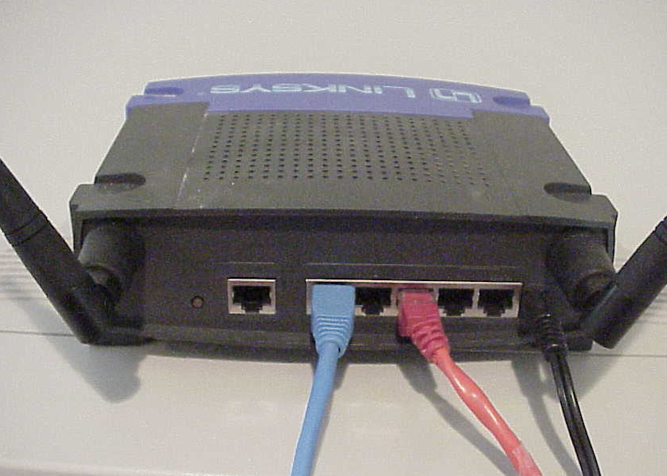
Installing a Hub, Switch, or AP
Connect network cables
Connect AC power to device
Start up PC(s) and test network connectivity

Slide 5
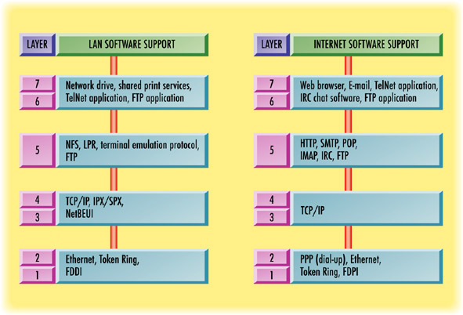
Networking Software and the OSI Model

Slide 6
Version Differences in Windows Networking
Windows 95, 98, Me
  Single set of properties for all networking as a whole
Windows 2000, XP
  Each network connection has its own properties
  Each network connection can have different protocols and services

Slide 7
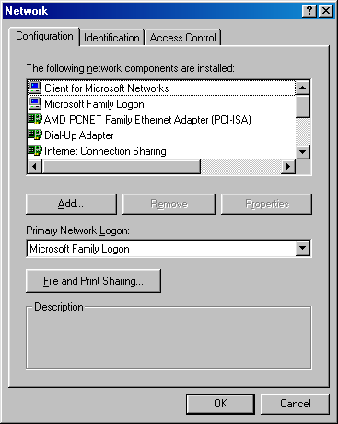
Windows 9x Networking
From Control Panel, choose Network
Add protocols and services
Configure TCP/IP for IP address

Slide 8
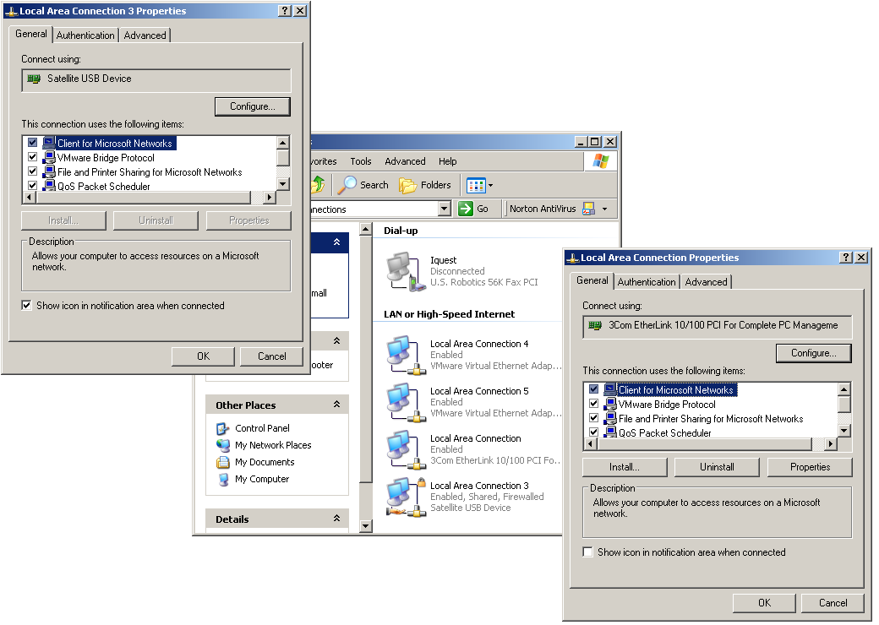
Windows 2000/XP Networking
Choose a network connection and then view its Properties

Slide 9
Network Client Software
Client for Microsoft Networks
  Might already be installed
  Installed during Windows Setup if a NIC is detected
  Installed when you run Network Setup Wizard
Client for Netware Networks
  Must be manually installed
  Not available in all versions

Slide 10
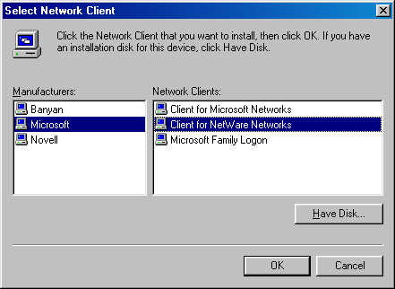
Manually Installing Network Client Software
Windows 9x/Me
  Add client from Networks dialog box
Windows 2000/XP
  Choose a network connection and add client for that connection

Slide 11
Protocols
TCP/IP
  Usually installed by default
  Required for Internet
  Used by most networks
NetBEUI
  Older, compact protocol
  Not routable
  Not available in Windows XP
IPX/SPX-Compatible
  Internetwork Packet Exchange/Sequenced Packet Exchange
  Required for Client for Netware Networks

Slide 12
Binding Protocols
Required in Windows 9x/Me because of the single set of Network settings
Associates a protocol with a client or NIC

Slide 13
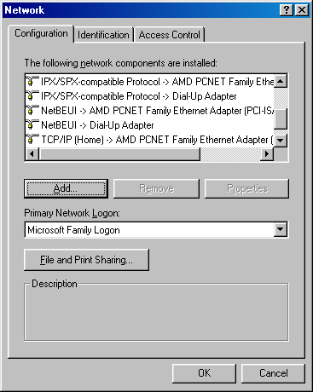
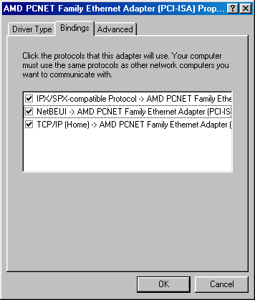
Binding Protocols

Slide 14
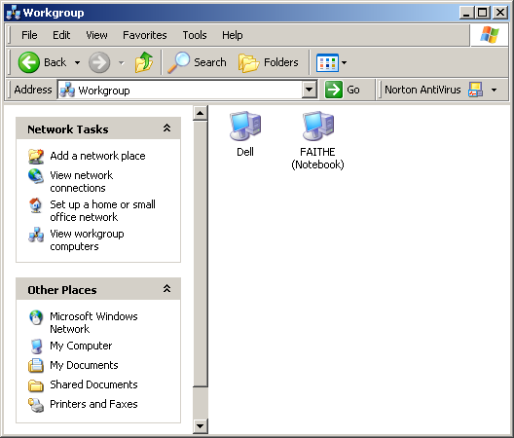
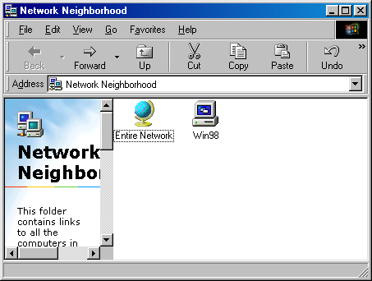
Checking for Network Connectivity
Browse My Network Places (or Network Neighborhood)

Slide 15
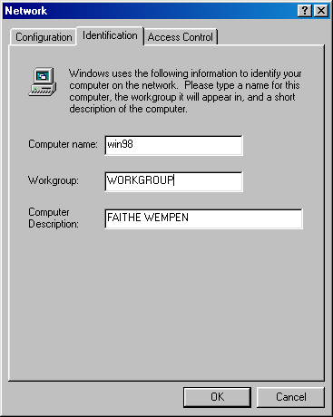
Changing the Computer Name and Workgroup Name
Windows 9x/Me: Identification tab in Network properties

Slide 16
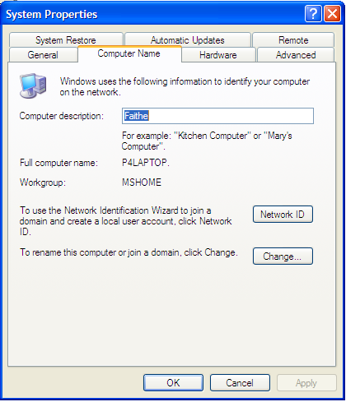
Changing the Computer Name and Workgroup Name
In System Properties:
  Windows 2000: Network Identification tab
  Windows XP: Computer Name tab in System properties

Slide 17
Network Setup with Wizards
Windows Me:
  Home Networking Wizard
Windows XP:
  Network Setup Wizard

Slide 18
Understanding TCP/IP
IP Addresses
  32-bit binary number
  Broken down into four 8-digit binary numbers
  Each binary number converted to decimal
  Example: 1100111.10010110.11000000.00001100
  (equivalent to 207.150.192.12)

Slide 19
Assigning IP Addresses
Static: Fixed address, assigned to each PC
Dynamic: Address assigned to the PC by a DHCP server
Automatic Private IP Address (APIPA): Address assigned by default if DHCP server is not available

Slide 20
Subnet Masks
Tells where the network address divides from the host address
Binary versions always have the 1s first, followed by the 0s
  Example, 11111111.11111111.11111111.00000000
  When converted to decimal:
  255.255.255.0

Slide 21
DNS Server
Stands for Domain Name System
Translates between URLs and IP addresses on the Internet
Many DNS servers on the Internet, all sharing data with one another

Slide 22
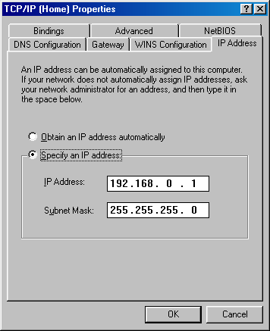
Checking PC’s IP Address
Windows 9x/Me:
View Network properties
View properties for TCP/IP
Look on IP Address tab

Slide 23
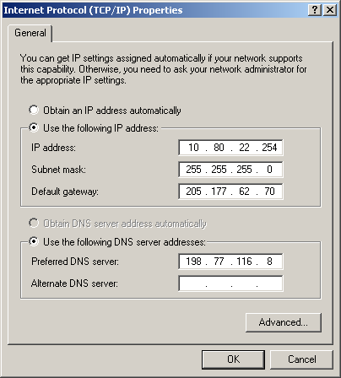
Checking PC’s IP Address
Windows 2000 or XP:
  Display properties for desired connection
  Display properties for TCP/IP

